Slide 1
OCR Reader

Slide 2


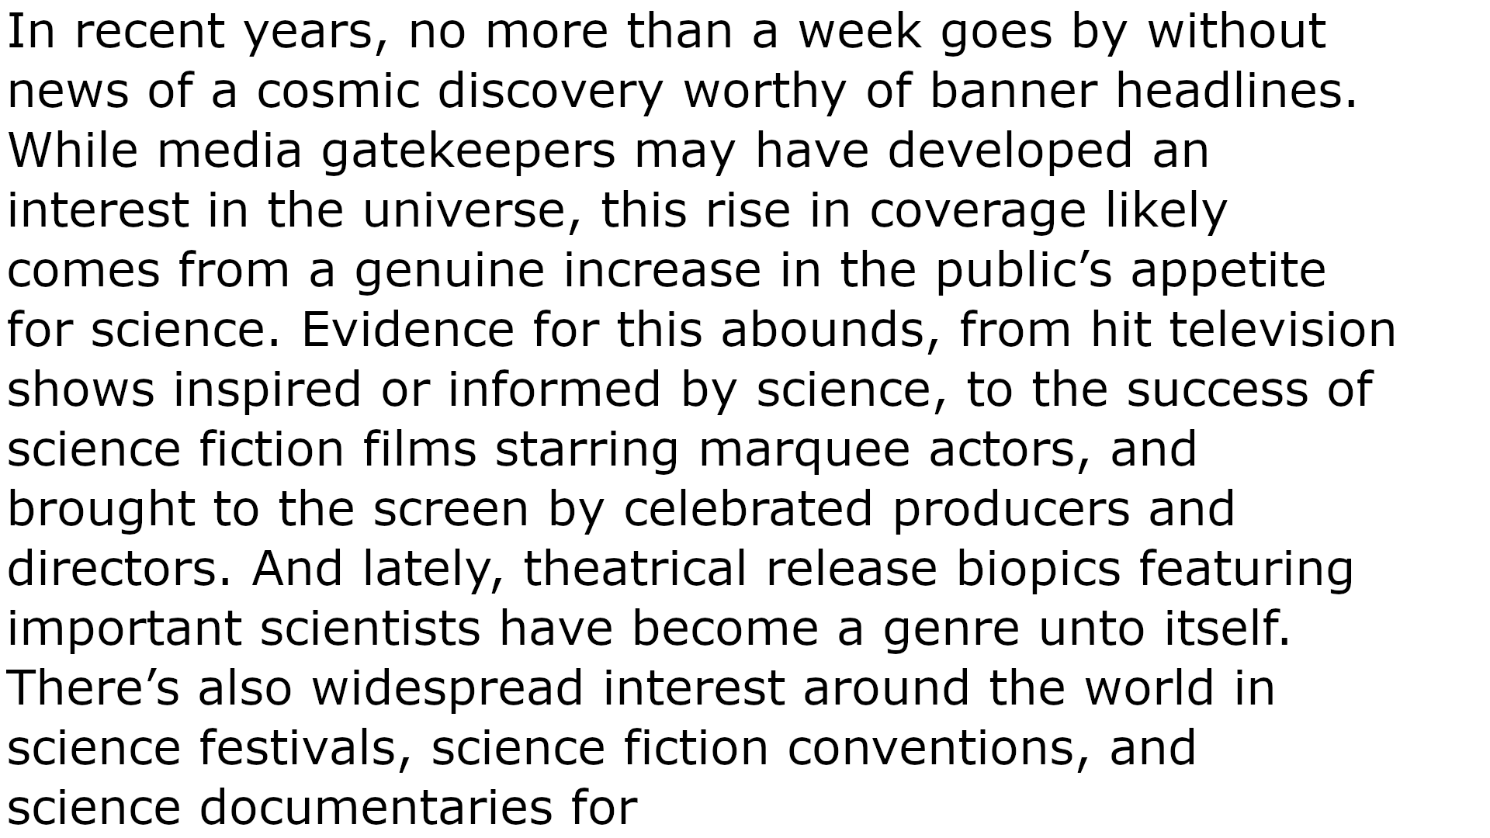
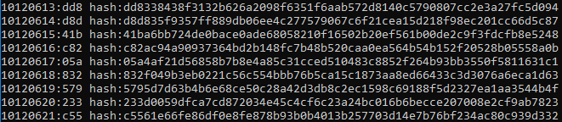
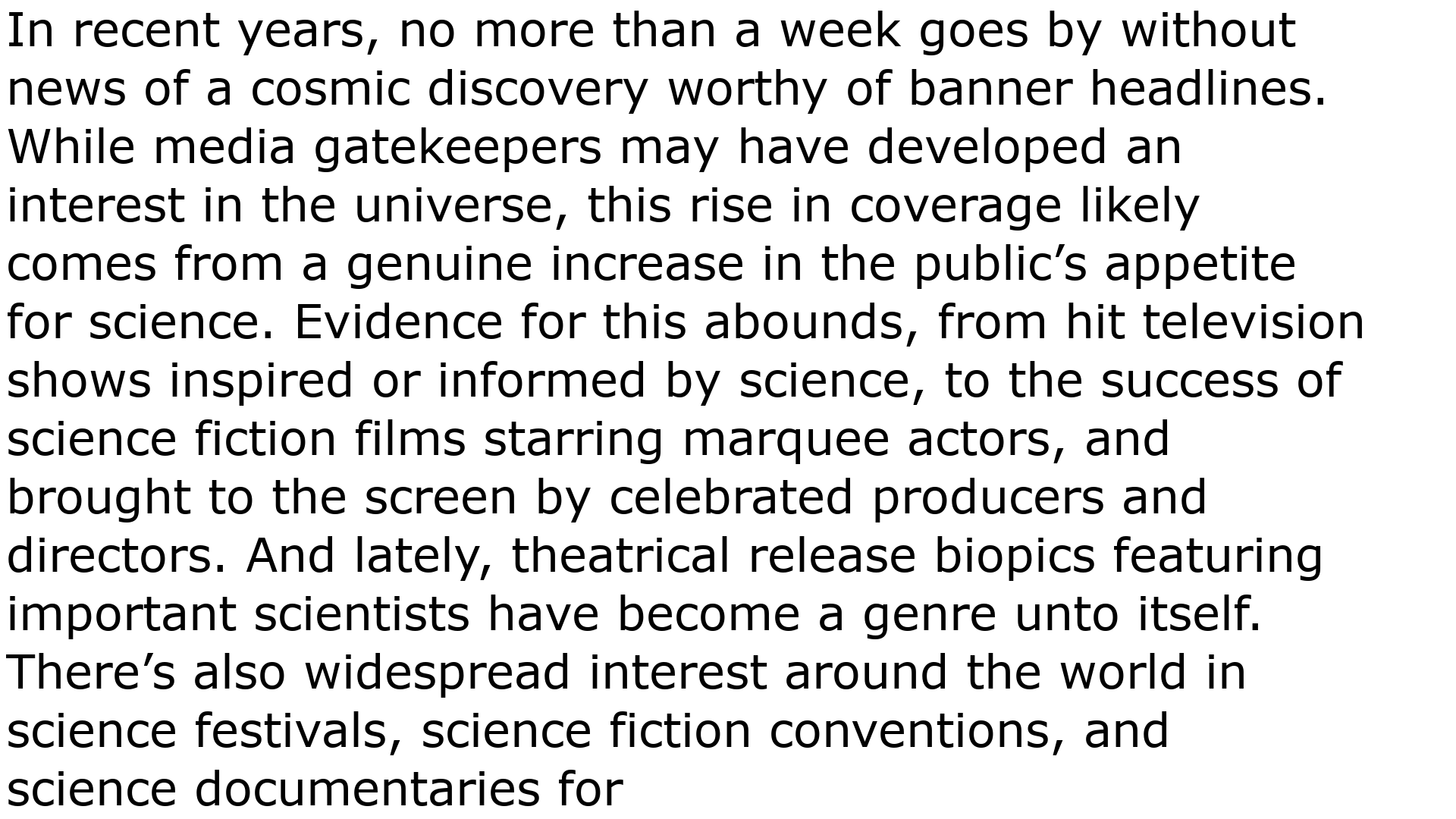
Capture document image
Save BlockChain
Prepare Imagen
Create BlockChain
Modeling and Saves text in blockchain
Run OCR

